Slide 1
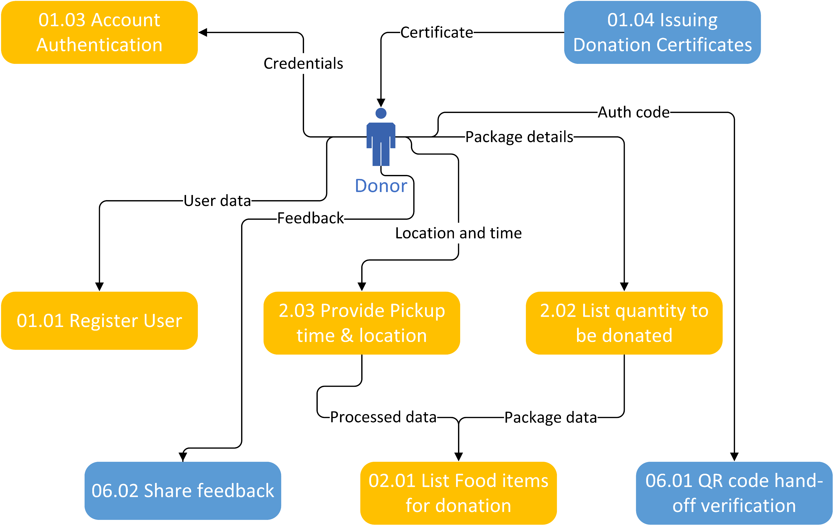
FoodPatry Data Flow Diagram(Logical)

